Slide 1
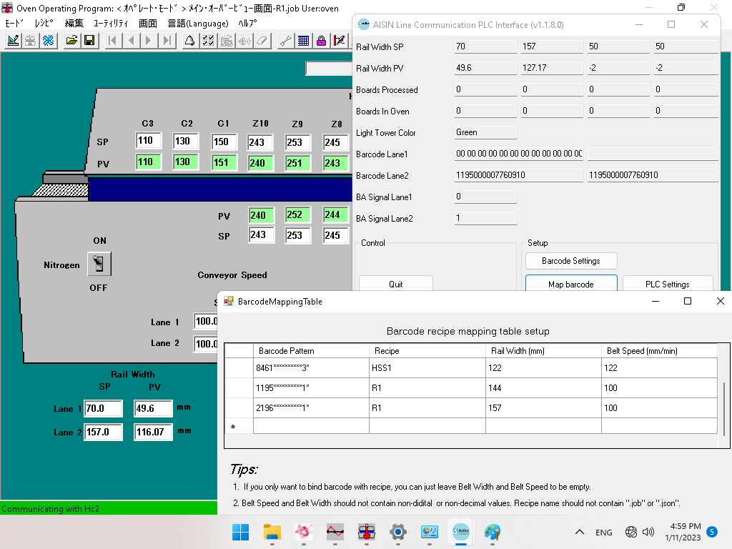
Slide 1
Barcode "2196000000000010" was sent to lane 2 (D100), recipe "R1" was loaded and rail width was moved to 157.

Slide 2
↓
5 boards (157mm wide) were loaded in lane 2.
↓
The barcode "1195000000000010" was sent to Lane 1 (D000).
↓
"144" is entered for Lane 1 Rail Width (SP), but the rail does not start moving.
↓
5 boards in lane 2 have been unloaded from the oven and the board count for lane 2 is now zero.
↓
"Rail 1 adjustment" error appeared.
We want the rail 1 to move so that a 144 wide board is loaded.

